Slide 1


Advanced Credit Card Fraud Detection
Building a Smart Machine Learning System using XGBoost
Hello everyone, My name is Hamid Leghari, and today I'm presenting my Data Science project based on the IEEE-CIS Fraud Detection dataset.
In this project, I built a complete machine learning pipeline that detects credit card fraud with very high recall, meaning it catches most fraud cases before they cause damage.

Slide 2
The Problem : Why Fraud Detection Matters
So first… what is fraud detection?
It is an automated system that checks every credit card transaction in real time and decides whether it is:
Genuine Or Fraud
Why is this important?
Credit card fraud causes billions of dollars in losses every year.
Banks process millions of transactions daily.
Manual checking is impossible.
Our goal is very clear:
✔ Catch as many fraud cases as possible (High Recall).
Balancing this is the real challenge.

Slide 3
Dataset:IEEE-CIS Competition (Kaggle 2019)
This dataset comes from a 2019 Kaggle competition hosted by IEEE and Vesta Corporation.
It contains real-world e-commerce transaction data.
Dataset size:
590,540
434
400+
rows
columns
rich features
Examples of features:
Transaction amount
Card information
Email domain
Device and browser data
Identity-related metadata
This is not a simple dataset. It is large, complex, and very realistic.

Slide 4


Exploratory Data Analysis (EDA)
One major challenge: Class Imbalance
96.5%
3.5%
transactions are normal
are fraud
That means the model can easily ignore fraud if we are not careful.
Another big challenge: There were many missing values.
But we did NOT remove them.
Because in fraud detection:
👉 Missing information can itself be suspicious.
Sometimes fraudsters hide device details or identity intentionally.
So instead of deleting missing data, we engineered features around it.
Fraud detection is difficult because fraud patterns are rare and constantly changing.

Slide 5
Feature Engineering: 7 Key Techniques
Here are the 7 core feature engineering techniques that power our fraud detection model:
Missing Value Strategy
Time-Based Features
Transaction Velocity
Spending Behavior & User Profiles
Composite User Profiles (UIDs)
Device and Browser Strategy
Hybrid Categorical Encoding
Each technique is detailed on the following slides.

Slide 6

1.Missing Value Strategy
Missing Value Imputation
train[num_cols] = train[num_cols].fillna(-999) train[object_cols] = train[object_cols].fillna('missing')
Explanation:
We did not delete missing values.
Instead:
Numerical → -999
Text → "missing"
Logic:
In fraud detection, missing data can mean hidden identity.
Tree-based models like XGBoost can learn that -999 itself is suspicious.

Slide 7
2.Time-Based Features
Datetime Extraction
train['TransactionDT'] = pd.to_datetime(train['TransactionDT'], unit='s')
train['DT_hour'] = train['TransactionDT'].dt.hour
train['DT_day'] = train['TransactionDT'].dt.day
train['DT_weekday'] = train['TransactionDT'].dt.weekday
Explanation:
We converted a raw seconds column into real calendar time.
Then we extracted:
Hour
Day
Weekday
Logic:
Human behavior follows time patterns.
For example:
Fraud may increase at 3 AM
Or during weekends
Or during specific days
Benefit:
This helps the model detect suspicious timing patterns in transactions.

Slide 8
3.Transaction Velocity
Time Difference Between Transactions
train = train.sort_values(['card1', 'TransactionDT'])
train['time_diff'] = train.groupby('card1')['TransactionDT'].diff().dt.total_seconds()
train['time_diff'] = train['time_diff'].fillna(-1)
Explanation:
We sorted transactions by card number and time.
Then we calculated how many seconds passed between consecutive transactions for the same card.
Logic:
Normal users:
Fraudsters:
Buy occasionally
Take hours or days between purchases
Try many transactions quickly
Before the card gets blocked
This measures transaction "speed".
Benefit:
It creates a powerful velocity feature that catches rapid fraud attacks.

Slide 9
4.Spending Behavior & User Profiles
Card-Level Aggregations
agg_funcs = ['count', 'mean', 'std']
for col in ['card1', 'card2']:
for func in agg_funcs:
train[f'{col}_{func}_amt'] = train.groupby(col)['TransactionAmt'].transform(func)
Explanation:
For each card, we calculated:
Total transactions (count)
Average spending (mean)
Spending variation (std)
Logic:
Every card has a "normal spending pattern".
If a card usually spends $20, and suddenly spends $2000, that is suspicious.

Slide 10
5.Composite User Profiles (UIDs)
train['uid'] = train['card1'].astype(str) + '_' + train['addr1'].astype(str)
train['uid2'] = train['uid'] + '_' + train['P_emaildomain'].astype(str)
train['uid2_TransactionAmt_mean'] = train.groupby('uid2')['TransactionAmt'].transform('mean')
Explanation:
We combined:
Card number
Address
Email domain
To create a unique user identity.
Logic:
One feature alone may be weak. But combining them creates a strong digital identity.
Benefit:
This builds a detailed behavioral profile that makes fraud harder to hide.

Slide 11
6. Device & Browser Strategy
Device & Browser Cleaning
resolution_split = train['id_33'].str.split('x', expand=True)
train['screen_width'] = resolution_split[0].astype(float)
train['screen_height'] = resolution_split[1].astype(float)
train['browser_clean'] = train['id_31'].str.lower()
Explanation:
We cleaned messy device data:
Split resolution into width & height
Standardized browser names
Logic:
Fraud rings often use:
Automated scripts
Emulators
Outdated browsers
These features capture their technical fingerprint.

Slide 12
7.Hybrid Categorical Encoding
if train[col].nunique() <= low_card_thresh:
dummies = pd.get_dummies(train[col], prefix=col)
else:
freq = train[col].value_counts() / len(train)
train[col] = train[col].map(freq)
Explanation:
If categories are small → One-Hot Encoding
If categories are large → Frequency Encoding
Logic:
Models need numbers, not text.
We can't create 5000 columns for email domains.
So we convert high-cardinality text into meaningful numeric frequency scores.
Benefit:
Efficient, scalable, and model-friendly.

Slide 13
HOW WE HANDLED IMBALACMENT OF DATA?
BY USING:
scale_pos_weight = (normal_count / fraud_count)
What this does: This makes the model pay more attention to the rare cases of fraud. Normally, the model sees so many normal transactions that it might ignore the few fraudulent ones. By doing this, we make mistakes on fraud cases "feel" more costly to the model, so it learns to treat them more seriously

Slide 14

MODEL SELECTION:
Why I Chosed XGBoost?
Excellent for tabular data
Handles missing values well
Fast and powerful
Strong performance in Kaggle competitions

Slide 15


Model Evaluation:
Final Performance Highlights
ROC-AUC: 94%
Recall: 89.17%
→ It clearly separates fraudulent and legitimate transactions, helping reduce both false alarms and missed fraud cases
→ It catches almost 9 out of 10 fraud cases, helping prevent losses and keep revenue safe.
A high ROC AUC and Recall indicate that our model is very effective at detecting fraudulent transactions.

Slide 16
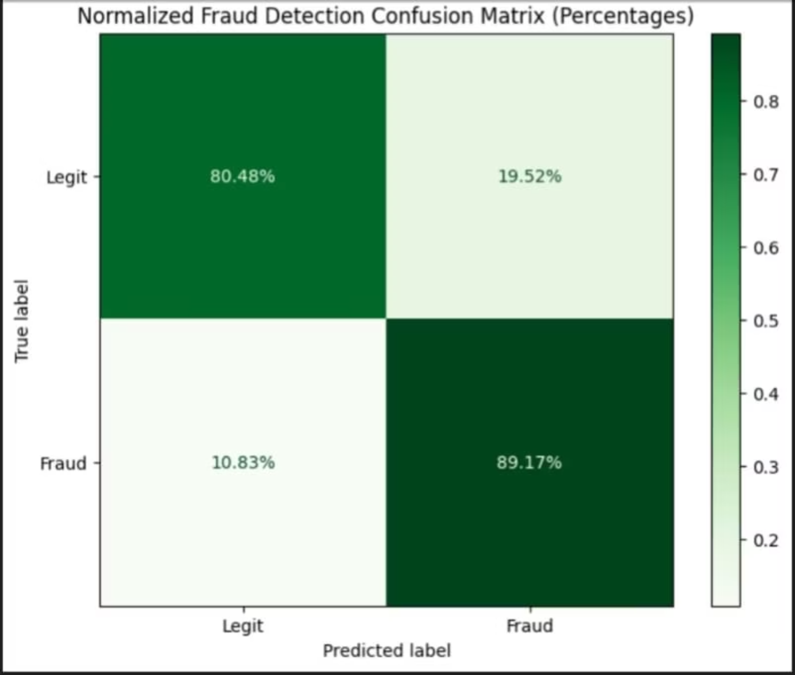
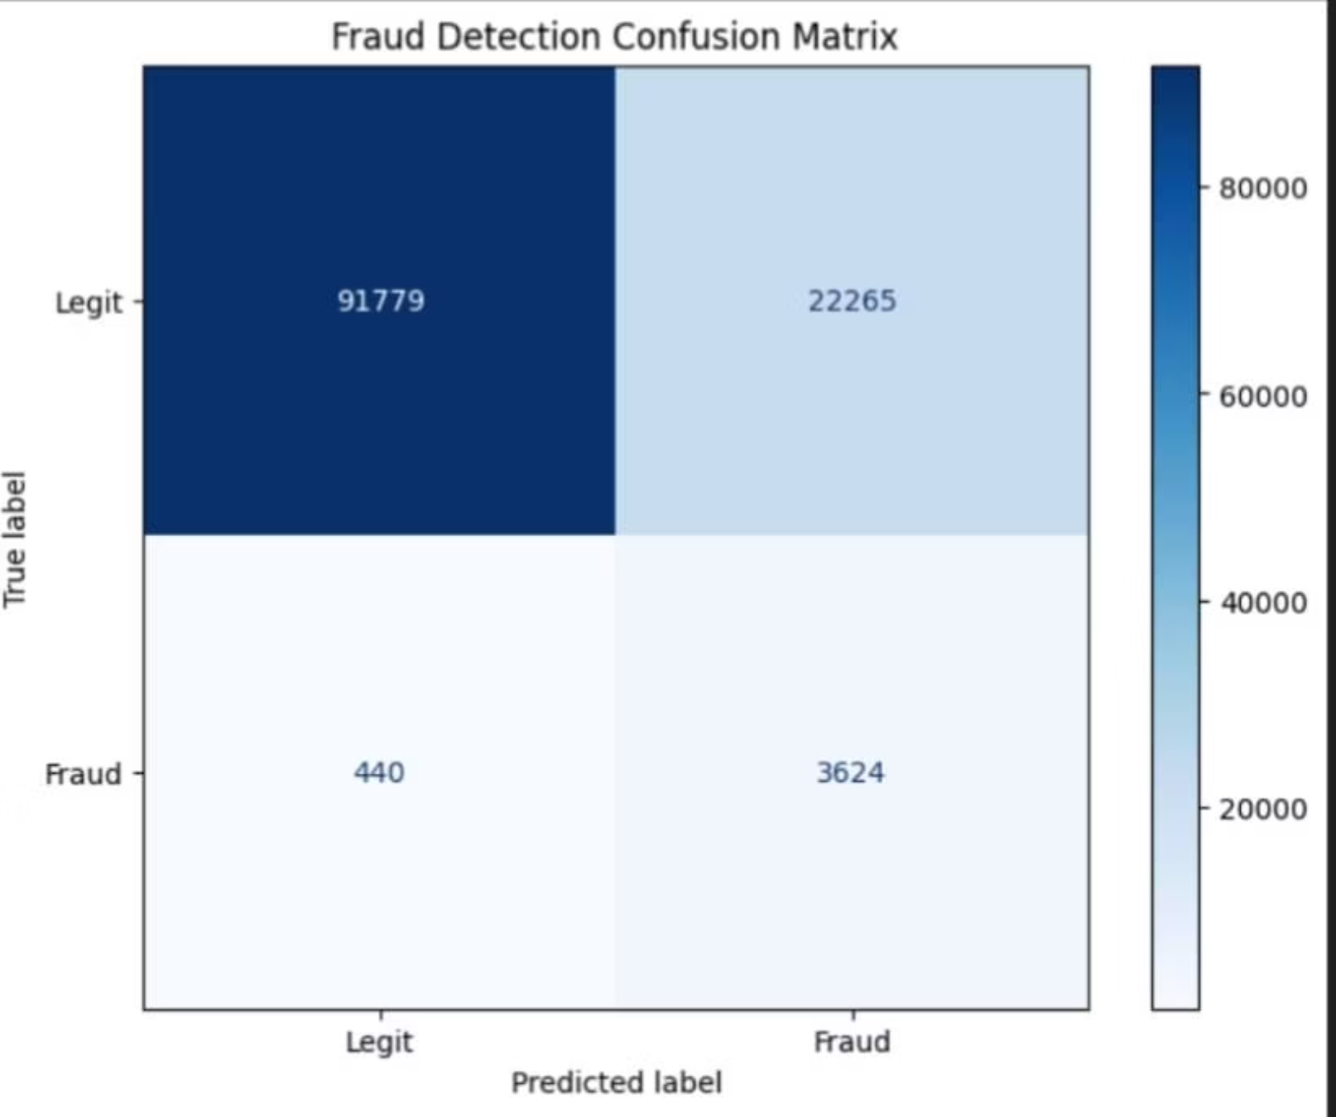
Confusion Matrices:

Slide 17
Future Improvements & Scaling:
Real-Time Processing
Deep Learning Integration
Move from batch to streaming scoring to deliver sub-second risk decisions, enabling earlier interdiction and smoother customer experience.
Add neural models (sequence and graph-aware) alongside current models in an ensemble to catch complex fraud patterns while controlling latency.
Adaptive Models
Multi-Channel Detection
Automate retraining with drift detection and safe rollouts so models stay current as fraud tactics evolve.
Unify event schemas and centralize features to extend coverage across ACH, transfers, wallets, BNPL, and in-app payments.
Explainability
Infrastructure Scaling
Provide clear, model-backed explanations and investigator-facing dashboards to speed decisions and satisfy compliance.
Design horizontally scalable scoring services, autoscaling inference fleets, and multi-region failover to meet throughput and availability targets.

Slide 18

Thank You!
Thank you so much for your time and attention today! I hope this presentation helped you see just how important advanced fraud detection is and gave you a clear idea of how we can protect financial transactions using Machine Learning.
.

